Slide 1

DC Circuits
Series Circuits
By Dr. Ahmed S. Abdullah
د. احمد سليمان عبدالله

Slide 2
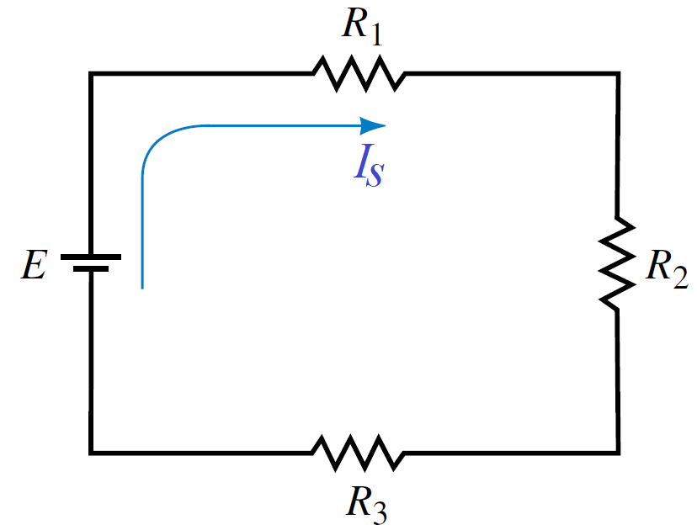
Series Circuits
Two elements are in series if
1. They have only one terminal in common (i.e., one lead of one is connected to only one lead of the other).
2. The common point between the two elements is not connected to another current-carrying element.
The current is the same through series elements.
The total resistance of a series circuit is the sum of the resistance levels.

Slide 3
Series Circuits
= 3.3 kΩ
= 56 kΩ
= 27 kΩ

Slide 4

Series Circuits
= 3.3 kΩ
= 56 kΩ
= 27 kΩ

Slide 5

Series Circuits
$$R_{T}=3.3+56+27=86.3 kΩ$$
= 3.3 kΩ
= 56 kΩ
= 27 kΩ

Slide 6
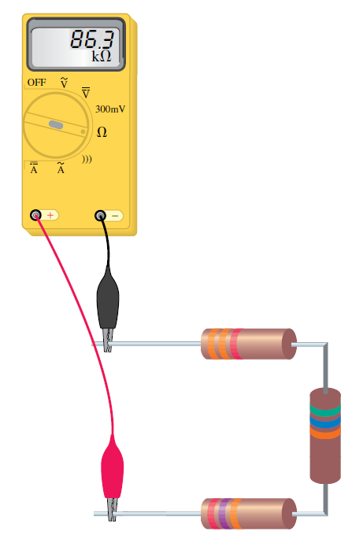
Series Circuits
$$R_{T}=3.3+56+27=86.3 kΩ$$
= 3.3 kΩ
= 56 kΩ
= 27 kΩ

Slide 7
Series Circuits
$$R_{T}=3.3+56+27=86.3 kΩ$$
= 3.3 kΩ
= 56 kΩ
= 27 kΩ

Slide 8

Series Circuits
$$R_{T}=3.3+56+27=86.3 kΩ$$
$$I_{s}= \frac{40}{86.3 ×{10}^{3}}=0.463 mA$$

Slide 9
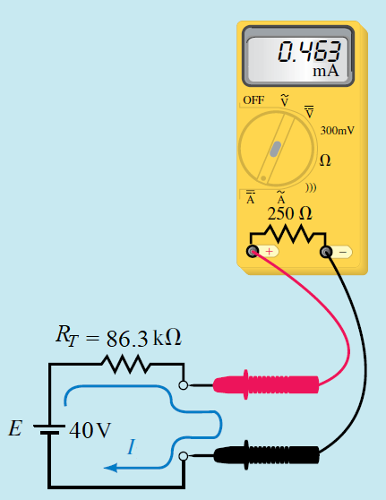
Series Circuits
$$R_{T}=3.3+56+27=86.3 kΩ$$
$$I_{s}= \frac{40}{86.3 ×{10}^{3}}=0.463 mA$$

Slide 10
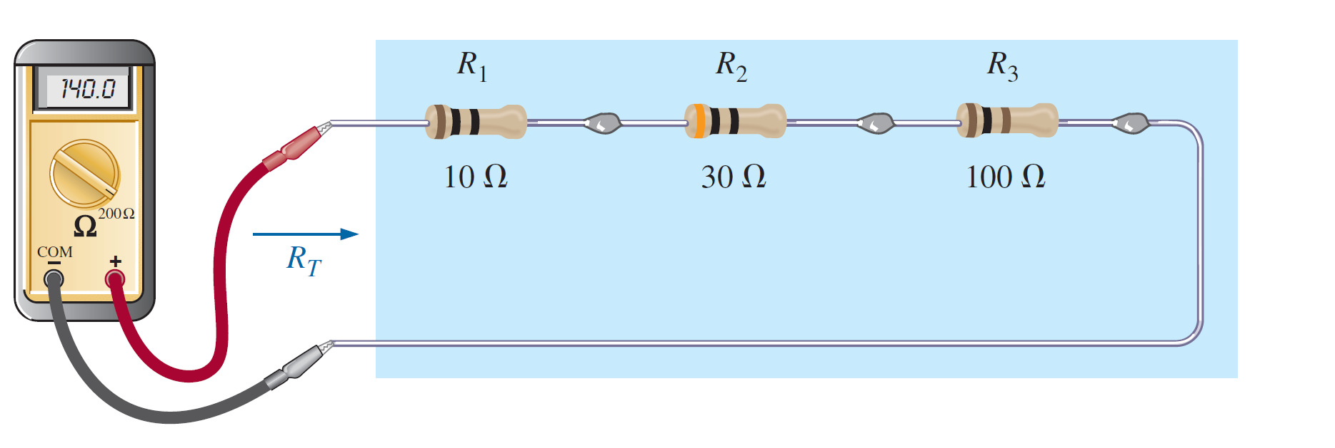

Series Circuits
$$R_{T}=10+30+100=140 Ω$$

Slide 11
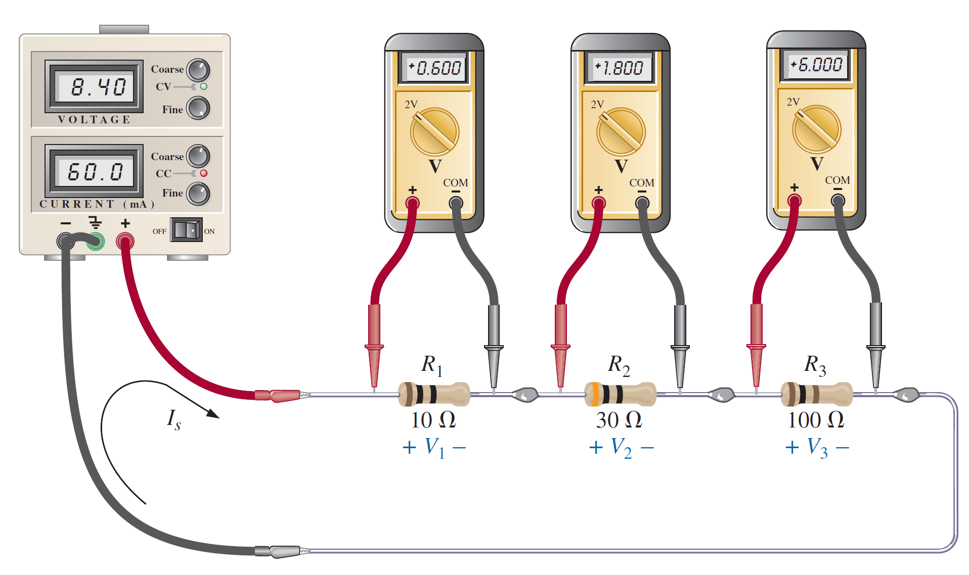


Series Circuits
$$R_{T}=10+30+100=140 Ω$$
$$I_{s}= \frac{8.4}{140}=0.06=60 mA$$
$V_{1}=$ $I_{s}R_{1}=0.06 ×10=0.6 V$
$V_{2}=$ $I_{s}R_{2}=0.06 ×30=1.8 V$
$V_{3}=$ $I_{s}R_{3}=0.06 ×100=6 V$
$E=V_{1}+{ V}_{2}$+ $V_{3}$
$$E=0.6+1.8+6=8.4 V$$

Slide 12
If a circuit has more than one voltage source in series, then the voltage sources may effectively be replaced by a single source having a value that is the sum or difference of the individual sources.
VOLTAGE SOURCES IN SERIES

Slide 13
Since the sources may have different polarities, it is necessary to consider polarities in determining the resulting magnitude and polarity of the equivalent voltage source.
VOLTAGE SOURCES IN SERIES

Slide 14
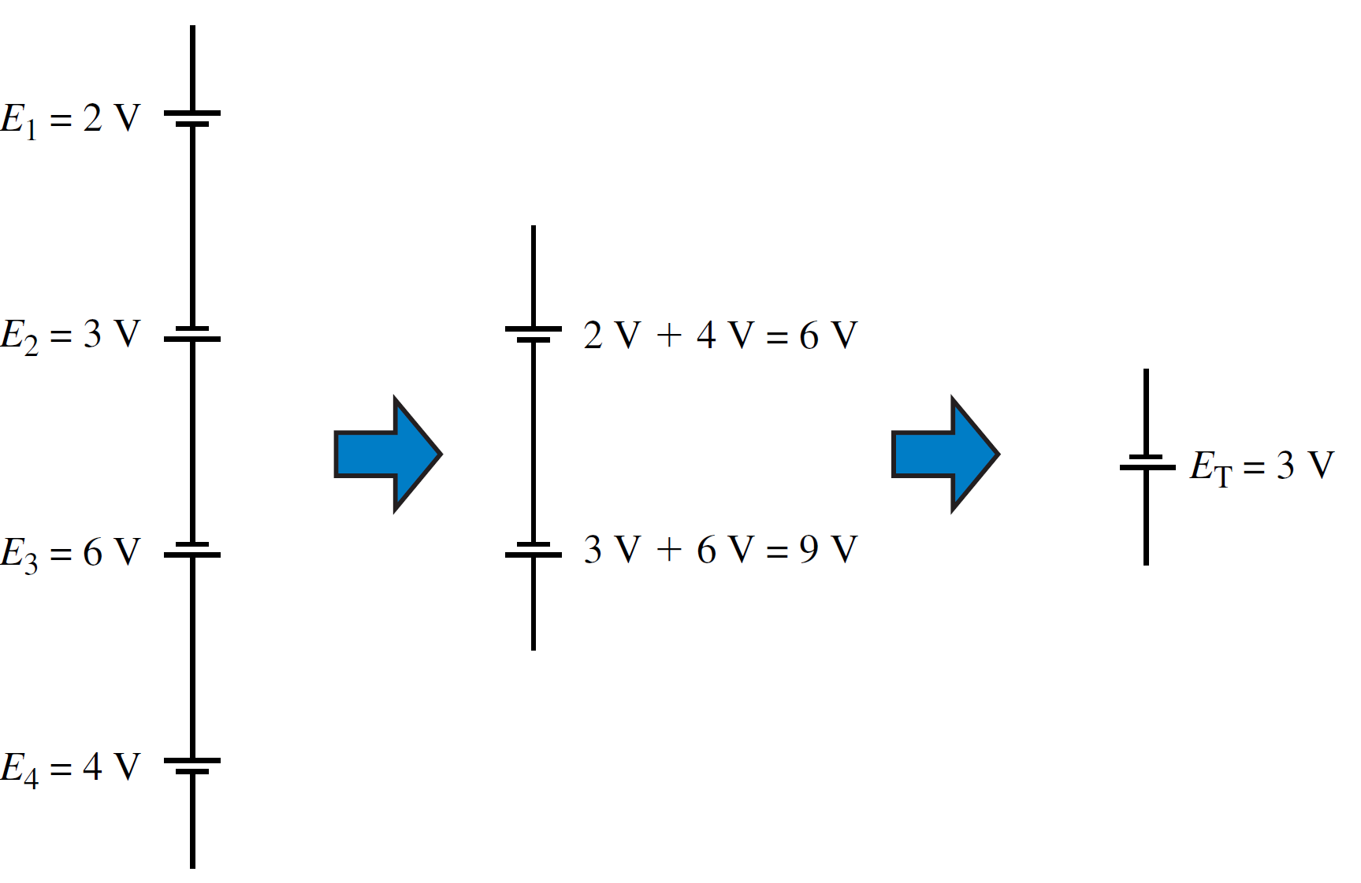
VOLTAGE SOURCES IN SERIES

Slide 15
VOLTAGE SOURCES IN SERIES

Slide 16
VOLTAGE SOURCES IN SERIES

Slide 17
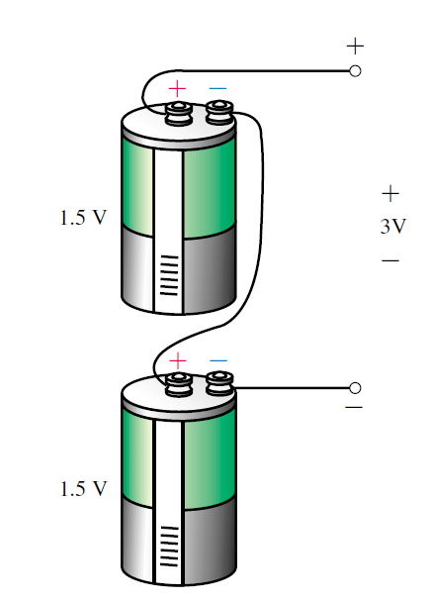
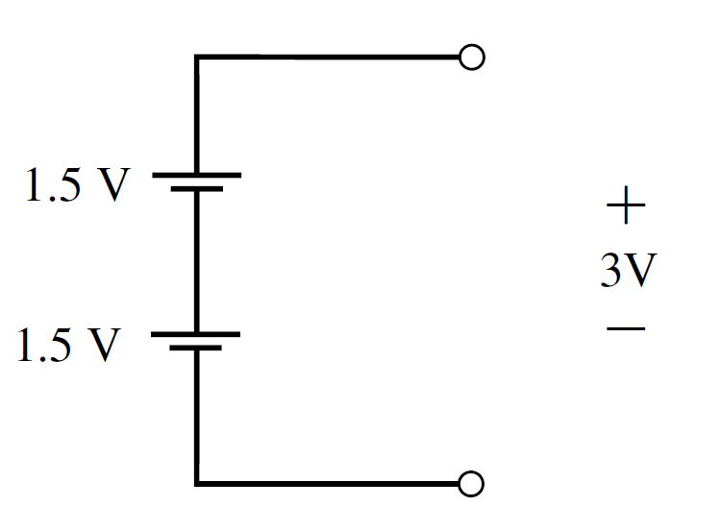
VOLTAGE SOURCES IN SERIES

Slide 18
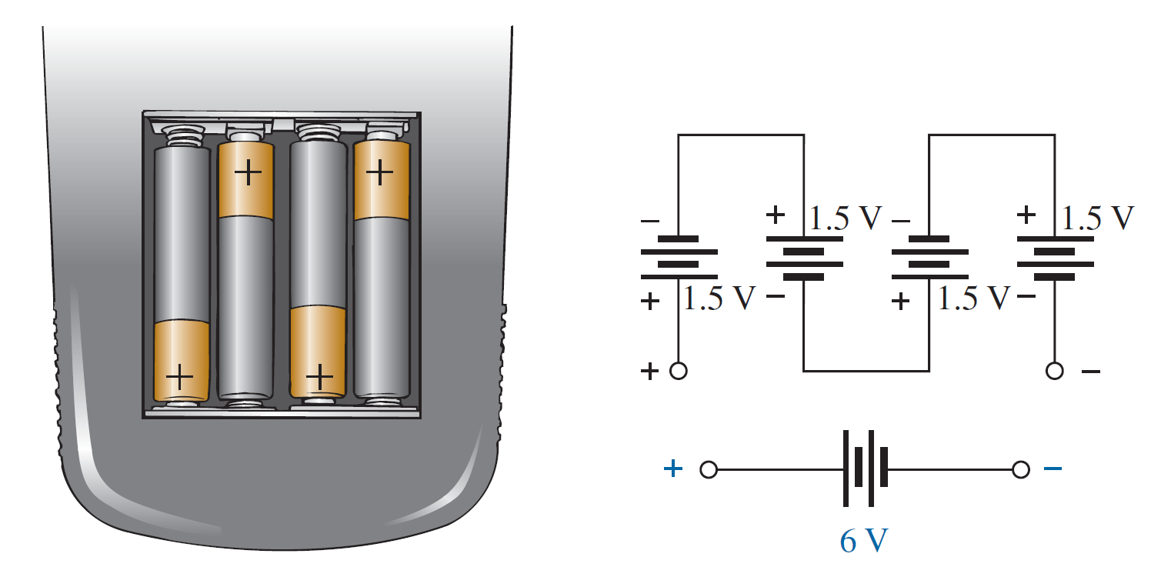
VOLTAGE SOURCES IN SERIES

Slide 19
Kirchhoff’s Laws
Kirchhoff’s voltage law (KVL) states that the algebraic sum of all voltages around a closed path (or loop) is zero.
Kirchhoff’s current law (KCL) states that the algebraic sum of currents entering a node (or a closed boundary) is zero.
Gustav Robert Kirchhoff

Slide 20
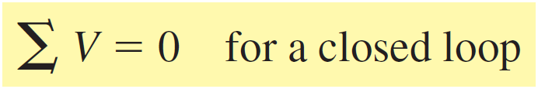

Kirchhoff’s voltage law (KVL)
Kirchhoff’s voltage law (KVL)
A closed loop is any continuous path that leaves a point in one direction and returns to that same point from another direction without leaving the circuit.

Slide 21
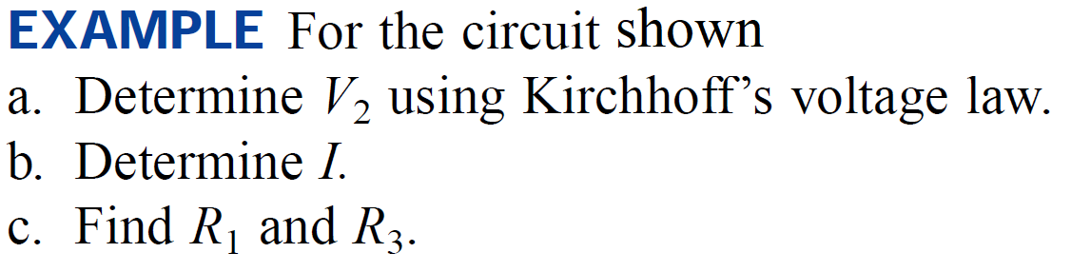
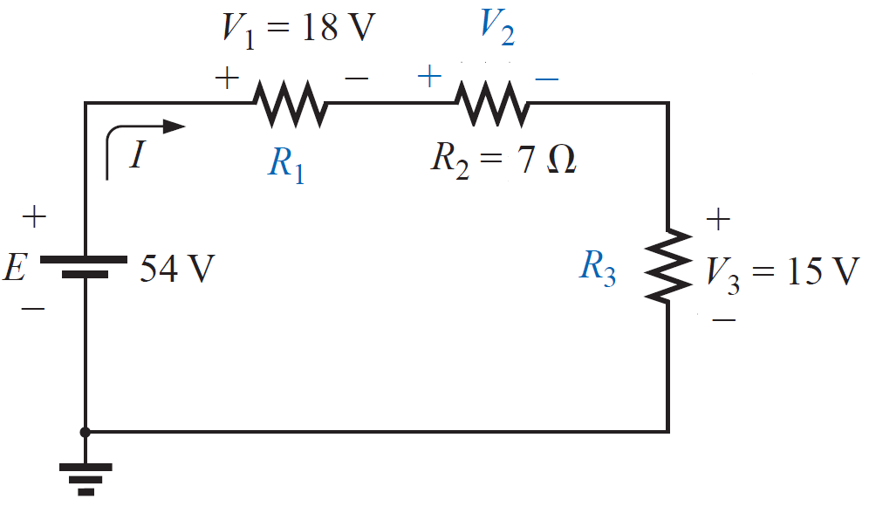
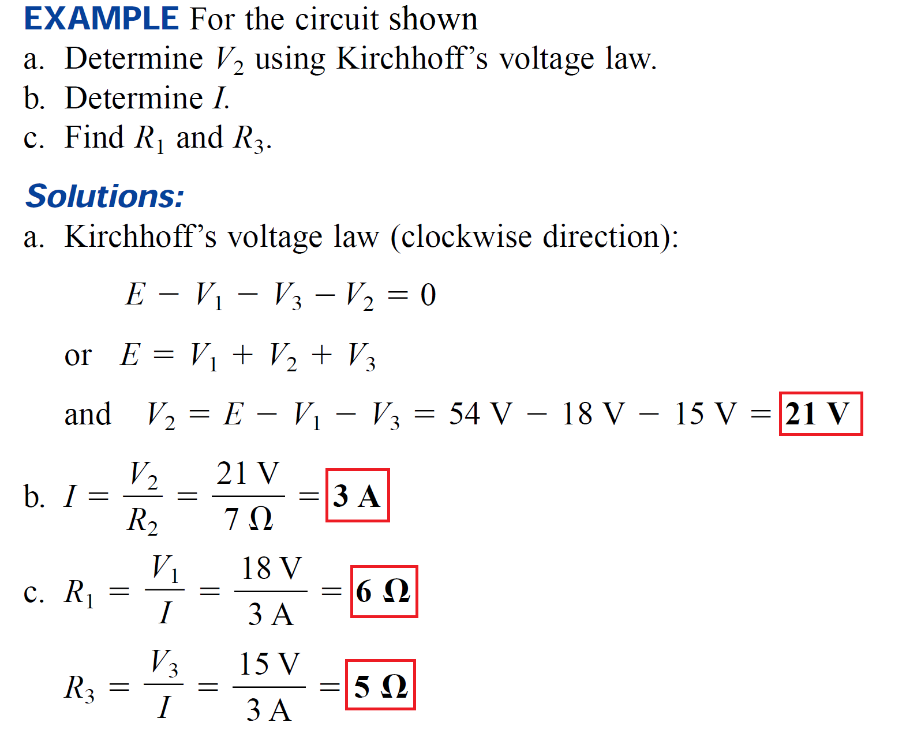
Kirchhoff’s voltage law (KVL)

Slide 22

Kirchhoff’s voltage law (KVL)

Slide 23
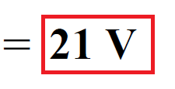
Kirchhoff’s voltage law (KVL)

Slide 24
Kirchhoff’s voltage law (KVL)

Slide 25
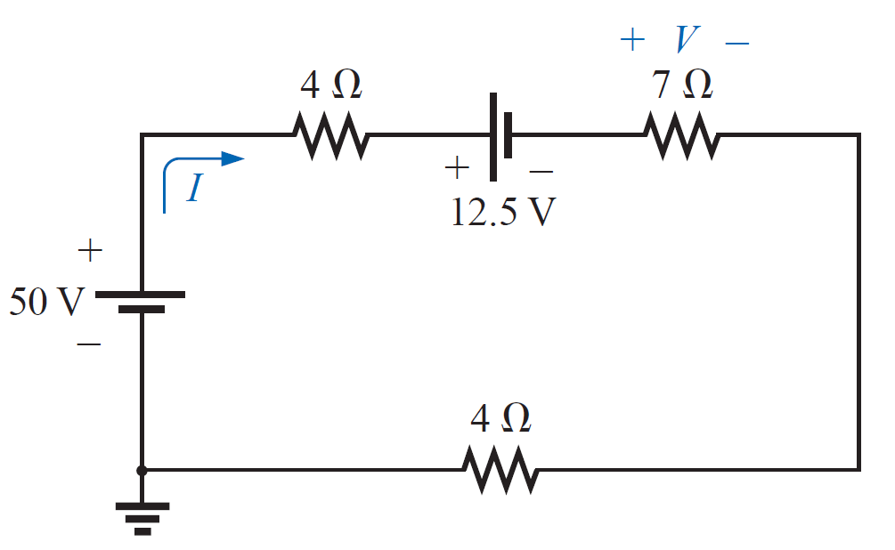
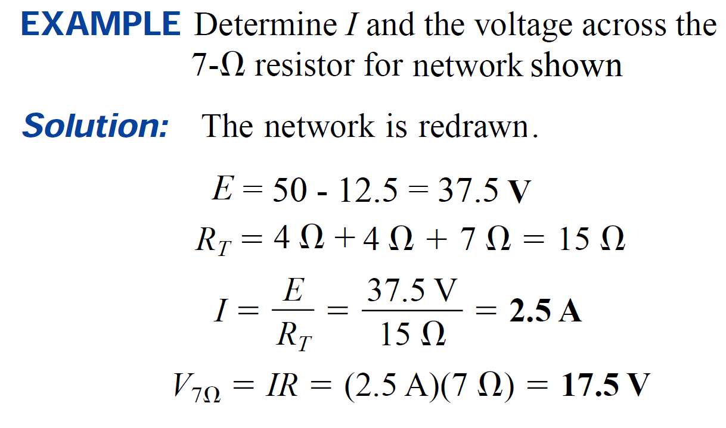
Kirchhoff’s voltage law (KVL)

Slide 26
Kirchhoff’s voltage law (KVL)

Slide 27
Kirchhoff’s voltage law (KVL)

Slide 28
Kirchhoff’s voltage law (KVL)

Slide 29
Kirchhoff’s voltage law (KVL)

Slide 30
Kirchhoff’s voltage law (KVL)

Slide 31
Kirchhoff’s voltage law (KVL)
EXAMPLE Simplify the circuit of Figure shown into a single source in series with the four resistors. Determine the magnitude of the current in the resulting circuit.

Slide 32
Kirchhoff’s voltage law (KVL)
EXAMPLE Simplify the circuit of Figure shown into a single source in series with the four resistors. Determine the magnitude of the current in the resulting circuit.

Slide 33
Kirchhoff’s voltage law (KVL)
EXAMPLE Simplify the circuit of Figure shown into a single source in series with the four resistors. Determine the magnitude of the current in the resulting circuit.

Slide 34
Kirchhoff’s voltage law (KVL)
EXAMPLE Simplify the circuit of Figure shown into a single source in series with the four resistors. Determine the magnitude of the current in the resulting circuit.

Slide 35
Kirchhoff’s voltage law (KVL)
EXAMPLE Simplify the circuit of Figure shown into a single source in series with the four resistors. Determine the magnitude of the current in the resulting circuit.

Slide 36
Kirchhoff’s voltage law (KVL)
EXAMPLE Simplify the circuit of Figure shown into a single source in series with the four resistors. Determine the magnitude of the current in the resulting circuit.
ET = E1 + E2 + E3
ET = 6V+1V - 2V = 5V

Slide 37
Kirchhoff’s voltage law (KVL)
EXAMPLE Simplify the circuit of Figure shown into a single source in series with the four resistors. Determine the magnitude of the current in the resulting circuit.
ET = E1 + E2 + E3
ET = 6V+1V - 2V = 5V
RT = R1 + R2 + R3 + R4
RT = 2 + 4 + 3 + 1 =10 Ω

Slide 38
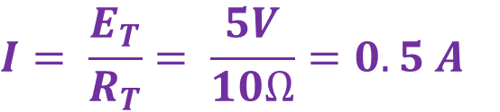
Kirchhoff’s voltage law (KVL)
EXAMPLE Simplify the circuit of Figure shown into a single source in series with the four resistors. Determine the magnitude of the current in the resulting circuit.
ET = E1 + E2 + E3
ET = 6V+1V - 2V = 5V
RT = R1 + R2 + R3 + R4
RT = 2 + 4 + 3 + 1 =10 Ω
$$I= \frac{E_{T}}{R_{T}}= \frac{5V}{10Ω}=0.5 A$$

Slide 39
The Voltage Divider Rule (VDR)
The voltage dropped across any series resistor is proportional to the magnitude of the resistor. The total voltage dropped across all resistors must equal the applied voltage source(s) by KVL.
The voltage divider rule allows us to determine the voltage across any series resistance in a single step, without first calculating the current. We have seen that for any number of resistors in series the current in the circuit is determined by Ohm’s law as

Slide 40
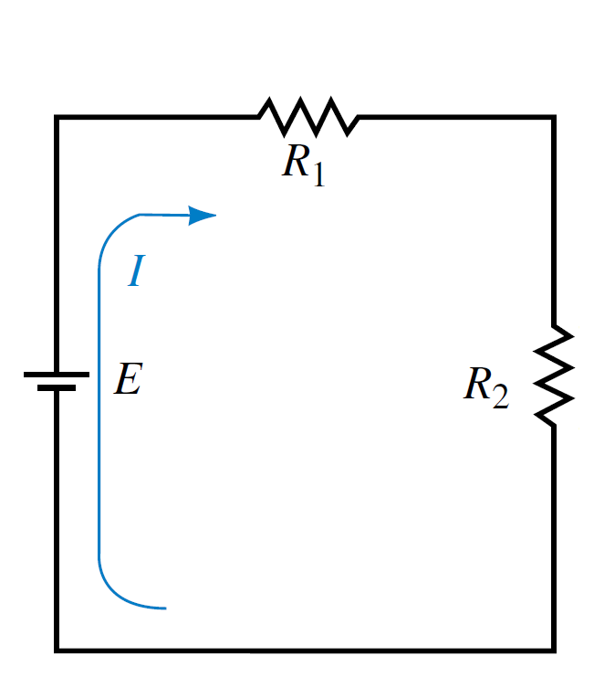
The Voltage Divider Rule (VDR)
The voltage dropped across any series resistor is proportional to the magnitude of the resistor. The total voltage dropped across all resistors must equal the applied voltage source(s) by KVL.
The voltage divider rule allows us to determine the voltage across any series resistance in a single step, without first calculating the current. We have seen that for any number of resistors in series the current in the circuit is determined by Ohm’s law as
By applying Ohm’s law,

Slide 41

The Voltage Divider Rule (VDR)
The voltage dropped across any series resistor is proportional to the magnitude of the resistor. The total voltage dropped across all resistors must equal the applied voltage source(s) by KVL.
The voltage divider rule allows us to determine the voltage across any series resistance in a single step, without first calculating the current. We have seen that for any number of resistors in series the current in the circuit is determined by Ohm’s law as
By applying Ohm’s law,

Slide 42

The Voltage Divider Rule (VDR)
The voltage dropped across any series resistor is proportional to the magnitude of the resistor. The total voltage dropped across all resistors must equal the applied voltage source(s) by KVL.
The voltage divider rule allows us to determine the voltage across any series resistance in a single step, without first calculating the current. We have seen that for any number of resistors in series the current in the circuit is determined by Ohm’s law as
By applying Ohm’s law,
By again applying Ohm’s law,

Slide 43
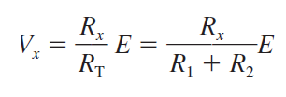
The Voltage Divider Rule (VDR)
The voltage dropped across any series resistor is proportional to the magnitude of the resistor. The total voltage dropped across all resistors must equal the applied voltage source(s) by KVL.
The voltage divider rule allows us to determine the voltage across any series resistance in a single step, without first calculating the current. We have seen that for any number of resistors in series the current in the circuit is determined by Ohm’s law as
By applying Ohm’s law,
By again applying Ohm’s law,

Slide 44
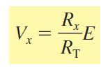
The Voltage Divider Rule (VDR)
The voltage dropped across any series resistor is proportional to the magnitude of the resistor. The total voltage dropped across all resistors must equal the applied voltage source(s) by KVL.
The voltage divider rule allows us to determine the voltage across any series resistance in a single step, without first calculating the current. We have seen that for any number of resistors in series the current in the circuit is determined by Ohm’s law as
By applying Ohm’s law,
By again applying Ohm’s law,

Slide 45
The Voltage Divider Rule (VDR)
EXAMPLE Use the voltage divider rule to determine the voltage across each of the resistors in the circuit shown . Show that the summation of voltage drops is equal to the applied voltage rise in the circuit.

Slide 46
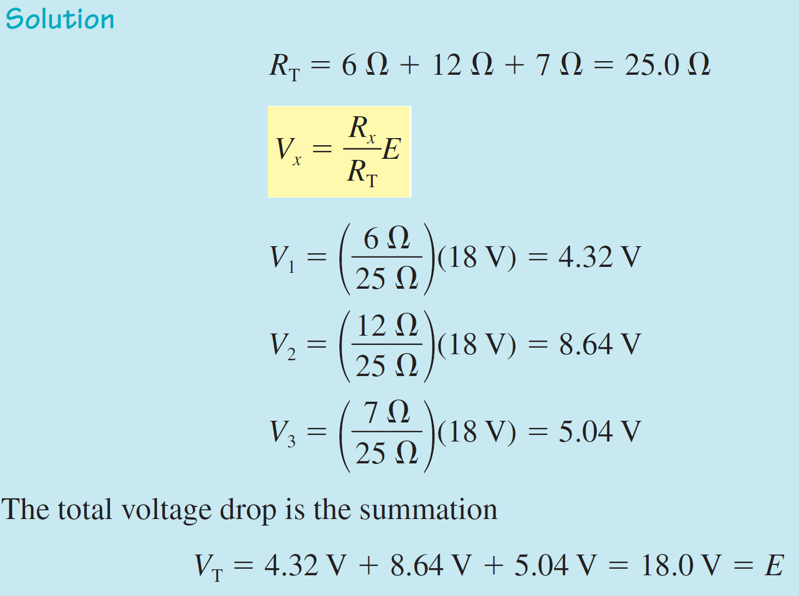
The Voltage Divider Rule (VDR)
EXAMPLE Use the voltage divider rule to determine the voltage across each of the resistors in the circuit shown . Show that the summation of voltage drops is equal to the applied voltage rise in the circuit.

Slide 47
The Voltage Divider Rule (VDR)
EXAMPLE Use the voltage divider rule to determine the voltage across each of the resistors in the circuit shown . Show that the summation of voltage drops is equal to the applied voltage rise in the circuit.

Slide 48
The Voltage Divider Rule (VDR)
EXAMPLE Use the voltage divider rule to determine the voltage across each of the resistors in the circuit shown . Show that the summation of voltage drops is equal to the applied voltage rise in the circuit.

Slide 49
The Voltage Divider Rule (VDR)
EXAMPLE Use the voltage divider rule to determine the voltage across each of the resistors in the circuit shown . Show that the summation of voltage drops is equal to the applied voltage rise in the circuit.

Slide 50
The Voltage Divider Rule (VDR)
EXAMPLE Use the voltage divider rule to determine the voltage across each of the resistors in the circuit shown . Show that the summation of voltage drops is equal to the applied voltage rise in the circuit.

Slide 51
The Voltage Divider Rule (VDR)
EXAMPLE Use the voltage divider rule to determine the voltage across each of the resistors in the circuit shown . Show that the summation of voltage drops is equal to the applied voltage rise in the circuit.

Slide 52
The Voltage Divider Rule (VDR)
EXAMPLE Using the voltage divider rule,
Determine the voltages V1 and V3 .
(b) Determine the voltage V' across resistors R₁ and R₂.

Slide 53
The Voltage Divider Rule (VDR)
EXAMPLE Using the voltage divider rule,
Determine the voltages V1 and V3 .
(b) Determine the voltage V' across resistors R₁ and R₂.

Slide 54
The Voltage Divider Rule (VDR)
EXAMPLE Using the voltage divider rule,
Determine the voltages V1 and V3 .
(b) Determine the voltage V' across resistors R₁ and R₂.

Slide 55
The Voltage Divider Rule (VDR)
EXAMPLE Using the voltage divider rule,
Determine the voltages V1 and V3 .
(b) Determine the voltage V' across resistors R₁ and R₂.

Slide 56
The Voltage Divider Rule (VDR)
EXAMPLE Using the voltage divider rule,
Determine the voltages V1 and V3 .
(b) Determine the voltage V' across resistors R₁ and R₂.

Slide 57
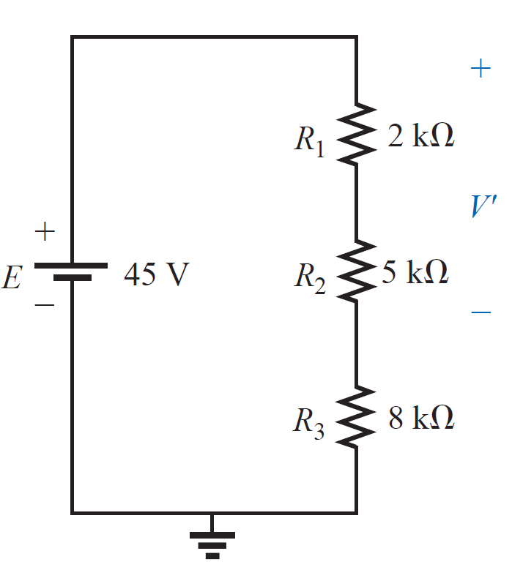
The Voltage Divider Rule (VDR)
EXAMPLE Using the voltage divider rule,
Determine the voltages V1 and V3 .
(b) Determine the voltage V' across resistors R₁ and R₂.

Slide 58
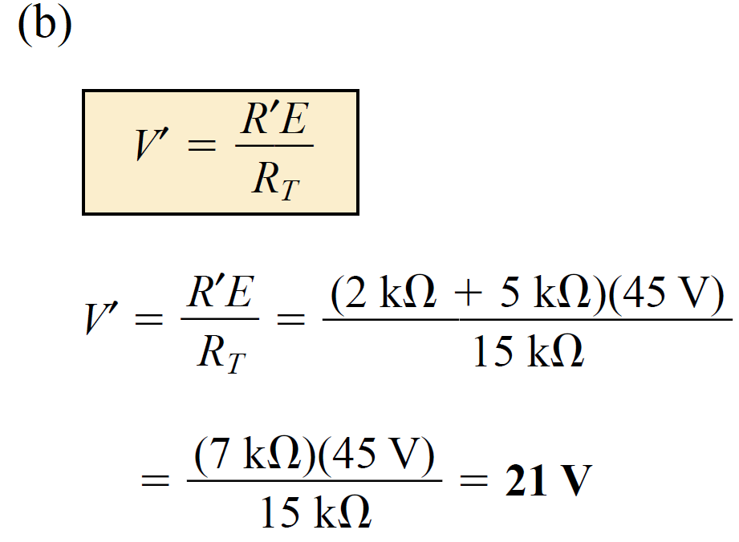
The Voltage Divider Rule (VDR)
EXAMPLE Using the voltage divider rule,
Determine the voltages V1 and V3 .
(b) Determine the voltage V' across resistors R₁ and R₂.

Slide 59
The Voltage Divider Rule (VDR)
EXAMPLE Using the voltage divider rule,
Determine the voltages V1 and V3 .
(b) Determine the voltage V' across resistors R₁ and R₂.

Slide 60

The Voltage Divider Rule (VDR)
EXAMPLE Using the voltage divider rule,
Determine the voltages V1 and V3 .
(b) Determine the voltage V' across resistors R₁ and R₂.
$$R^{′}=R_{1}+R_{2}$$

Slide 61
The Voltage Divider Rule (VDR)
EXAMPLE Using the voltage divider rule,
Determine the voltages V1 and V3 .
(b) Determine the voltage V' across resistors R₁ and R₂.
$$R^{′}=R_{1}+R_{2}$$

Slide 62
References
Boylestad, Robert L. Introductory circuit analysis. Pearson Education, 2010.
Robbins, Allan H., and Wilhelm C. Miller. Circuit analysis: Theory and practice. Cengage Learning, 2012.
Sadiku, Matthew NO, and Chales K. Alexander. Fundamentals of electric circuits. McGraw-Hill Higher Education, 2007.

